Slide 1
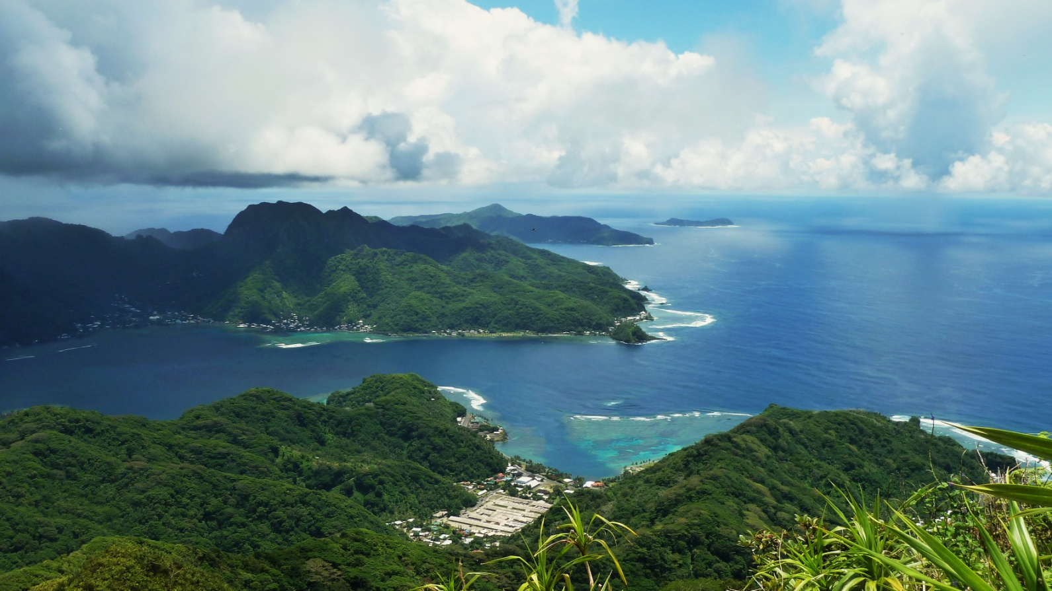


“Terrigenous sediment dynamics in a small, tropical fringing-reef embayment”
Prepared for Oral Exam and Proposal Defense
Alex Messina
Dissertation Committee:
Trent Biggs, Allen Hope
Bodo Bookhagen, Libe Washburn
Curt Storlazzi (USGS)

Slide 2
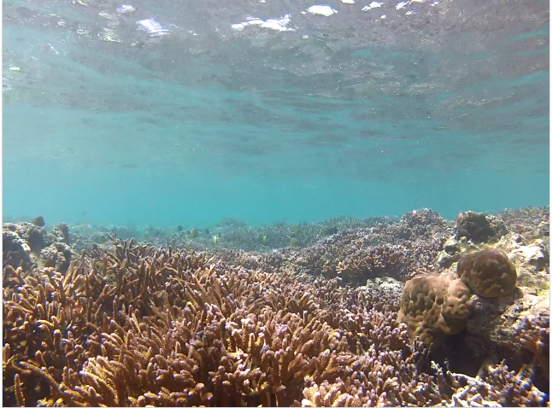
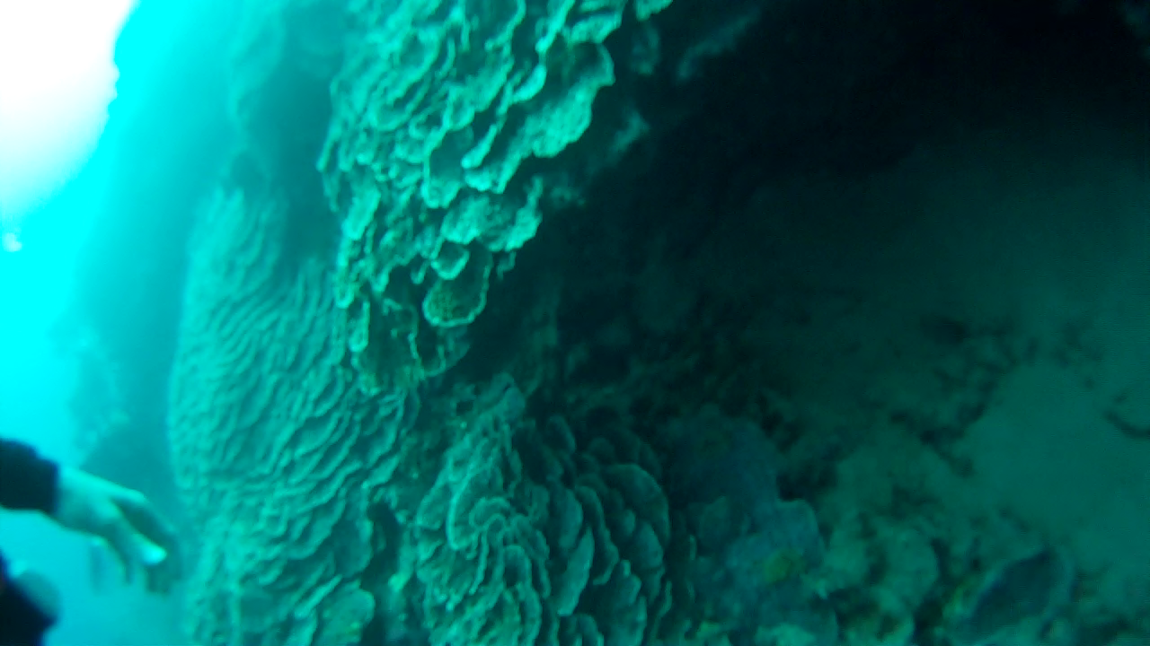
Introduction
Motivation:
Coral reefs are important sources of biodiversity, food, and recreation
Anthropogenic land surface disturbances increase sediment pollution to reefs
Sediment deposition and residence time on reefs is controlled by the interaction of watershed inputs and ocean circulation
Pristine Southern reef
Damaged Northern reef
Notes:
Sediment can bond with and transport other pollutants, attenuate light for photosynthesis, prevent larval recruitment, and stress or smother coral organisms
Anthropogenic watershed disturbance by industry, agriculture, deforestation, roads, and urbanization alters the timing, composition, and mass of sediment loads to coral reefs, causing enhanced sediment stress on corals near the outlets of impacted watersheds
Disturbance is exacerbated on tropical islands characterized by high rainfall, extreme weather events, steep slopes, erodible soils, and naturally dense vegetation, where land clearing alters the fraction of exposed soil much more than in regions with sparse vegetation
Deposited sediment can be resuspended due to wave action and reworked over the reef, causing persistent negative effects to ecosystem health or distributing impacts to larger areas
Damage to coral organisms and ecosystems is determined by the magnitude and duration of exposure, which are controlled by the interaction of sediment loading from the watershed, sediment availability on the reef, and hydrodynamic processes
An integrated understanding of how flood-supplied terrigenous sediment and water circulation control sediment deposition and residence time on reefs is essential for identifying and mitigating impacts on coral health

Slide 3
Research organized around three papers:
Paper One: Contributions of human activities to suspended sediment yield during storm events from a steep, small, tropical watershed
Quantify and model storm-generated sediment yield to the bay using in situ measurements and empirical models
Paper Two: Eulerian and Lagrangian measurements of water flow and residence time on a fringing reef embayment
Characterize flow velocities and residence times over the reef using a combination of Eulerian and Lagrangian measurements, and relate them to wave, wind, and tidal forcing
Paper Three: Watershed and oceanic controls on spatial and temporal patterns of sediment accumulation in a fringing reef flat embayment
Develop a spatially distributed model of net sediment accumulation based on sediment input from Paper One and water residence time over the reef from Paper Two
Notes:
SSYev empirical model will 1) determine which characteristics of precipitation and discharge control SSY_{EV} (Duvert et al., 2012), 2) provide a baseline to assess the effectiveness of future sediment mitigation at the quarry, and 3) will provide input to a model of sediment accumulation on the reef, developed in Paper Three.

Slide 4
Paper One: Contributions of human activities to suspended sediment yield during storm events from a steep, small, tropical watershed
Motivation
Identifying and quantifying sediment sources to focus management efforts
SSY data limited, existing models not well-calibrated on tropical, volcanic islands
Modeling SSY from small, mountainous catchments is significant at local and regional scales (Duvert 2012)
Research Questions
How has human disturbance increased sediment loading to Faga’alu Bay?
H: A quarry has increased sediment loading by an order of magnitude
2. How do sediment contributions from human-disturbed areas and undisturbed areas vary with storm size?
H: Human disturbance decreases with storm size
3. Which is the best predictor of storm event suspended sediment yield (SSY_{EV}): total precipitation, Erosivity Index, total discharge, or maximum event discharge?
H: Following Duvert 2012, Qmax will be best predictor
Notes:
Storm size: as documented in Mediterranean climates (White and Greer, 2006) and in Pacific Northwest forests (Lewis et al., 2001). As storm magnitude increases, water and/or SSY from natural areas may increase relative to human-disturbed areas, diminishing anthropogenic impact. While large storms account for most SSY in natural conditions, human-disturbed areas may show the most significant disturbance for smaller storms (Lewis et al., 2001).
SSY-Qmax correlation: High correlation between SSY_{EV} and Qmax has been found in semi-arid, temperate, and sub-humid watersheds in Wyoming (Rankl, 2004), Mexico, Italy, France (Duvert et al., 2012), and New Zealand (Basher et al., 2011; Hicks, 1990), but this approach has not been attempted for steep, tropical watersheds on volcanic islands.

Slide 5
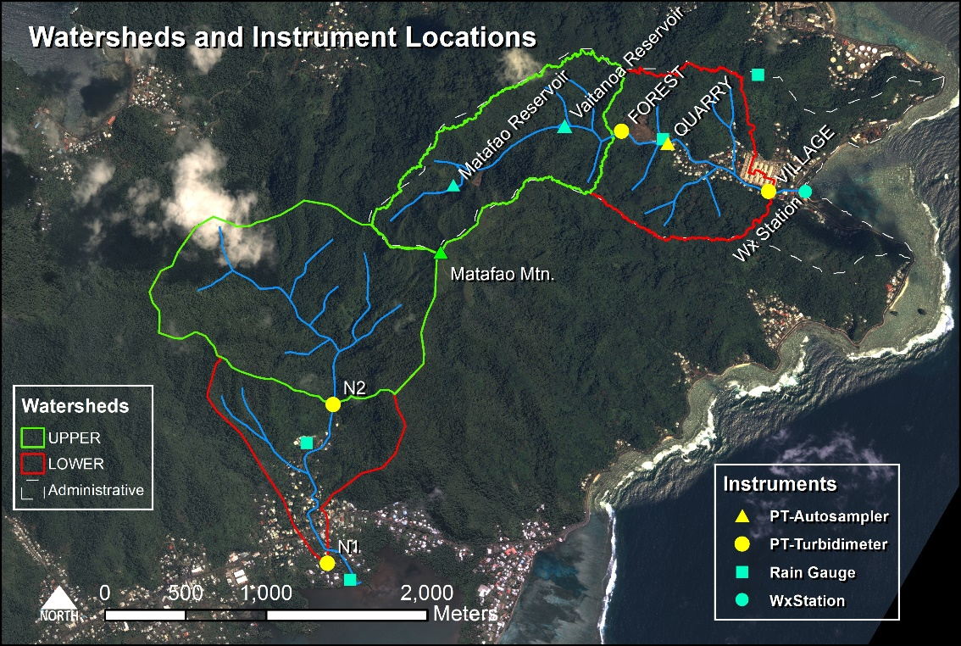
Study Site (Paper One)
Undisturbed, forested upper, and human-disturbed lower subwatersheds
Combination of paired and nested watershed approaches
Compare “typical” Nu’uuli with unique Faga’alu
Notes:
Describe each of the three watersheds in Faga’alu and the expectation of sediment flux patterns

Slide 6
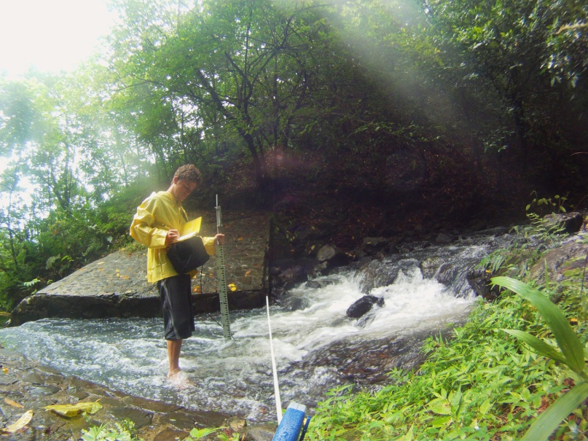
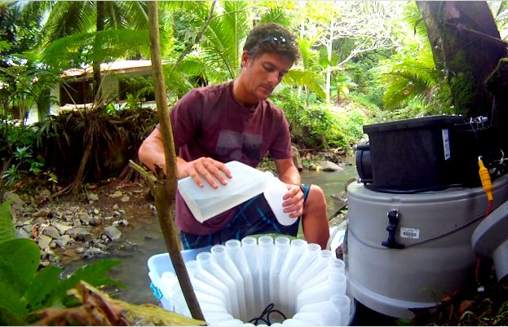
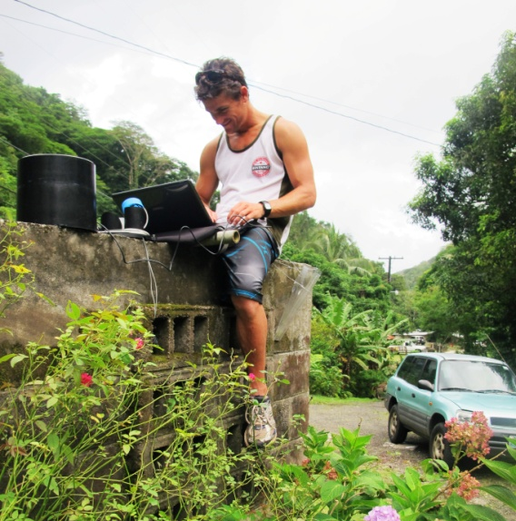


Methods
$${SSY}_{EV}= \int_{t=0}^{T}{Q∗SSC∗dt}$$
Quantify Event-wise suspended sediment yield:
Q from Stage/Discharge
SSC from Turbidity/SSC
P from Rain gauges
Model and Measurement Uncertainty
Root Mean Square Error (RMSE) method = ‘‘most probable value’’ of the cumulative error from each measurement and modeling procedure to the final SSY_{EV} estimate (SSY_{EV} ±PE)
$$PE= \sqrt{\sum{{(E}_{Qmeas}^{2}+E_{SSCmeas}^{2})+{(E}_{Qmod}^{2}+E_{SSCmod}^{2})}}$$

Slide 7



Methods
Disturbance Ratio
DR =$\frac{SSY}{{SSY}_{ pre}}$
$${SSY}_{pre}= {Area}_{TOTAL}∗ \left(\frac{{SSY}_{UPPER }}{{Area}_{UPPER}} \right)$$
Empirical model of SSY_{EV}
SSY_{EV} may be correlated with precipitation or discharge storm metrics (X):
total event precipitation (Psum)
EI30 rainfall erosivity (EI30)
total event discharge (Qsum)
peak event discharge (Qmax) (Duvert 2012)
Test using Pearson’s and Spearman’s (nonlinear)
$${SSY}_{EV}= αX^{β}$$
Comparing model parameters
Compare visually
Compare α and β coefficients
α relates to sediment availability
Β relates to increase with storm size
Disturbed
Sediment Yield; DR
Undisturbed
Storm Metric X (eg Qmax)
Notes:
DR = ratio of SSY_{EV} from the total human-disturbed watershed under current conditions (measured at the watershed outlet: VILLAGE and N1) to SSY under pre-disturbance conditions (SSY_{pre})
SSYpre is the specific sediment yield from the upper watershed x the area of the total watershed
Event wise, average, and plot as a function of event size

Slide 8
Paper Two: Eulerian and Lagrangian measurements of water flow and residence time on a fringing reef embayment
Motivation
Hydrodynamics control sediment dispersal, deposition, resuspension
Current conservation is based on distance-based plume models
Vetter (2013) calculated flushing time; highly dependent on unverified bathymetric data, no spatial variation of flow velocities
Research Questions
How do flow velocities and residence time of water over the reef vary spatially?
H: Flow velocity is higher (and residence time lower) near the southern reef crest, and the southern reef on average compared to northern reef
2. How are flow velocities and residence time of ocean water over the reef controlled by wave-, wind-, and tidal-forcing?
H: Flow velocities are higher, and more coherent under high wave conditions and flow velocities are lower and less coherent under tidal and wind forcing
Notes:
Hydrodynamics control orbital velocities, bed shear stresses, and water residence time
but fringing-reef environments are characterized by heterogeneous waves and currents over relatively small (hundreds of meters) spatial scales, unlike linear sandy shorelines

Slide 9
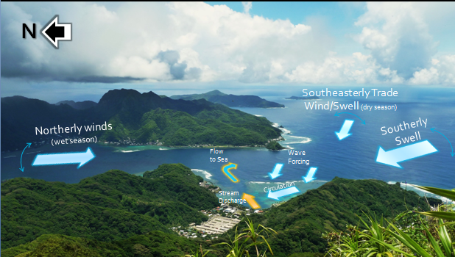
Study Site (Papers Two and Three)
Typical of reefs adjacent volcanic, tropical islands
Flow velocities are highly spatially variable (contrast linear beaches)
Wave-dominated flows are cross-shore and into deep channel
Wind-driven flows typically follow wind direction
Trade wind influenced seasonal modes (wet season/dry season)

Slide 10
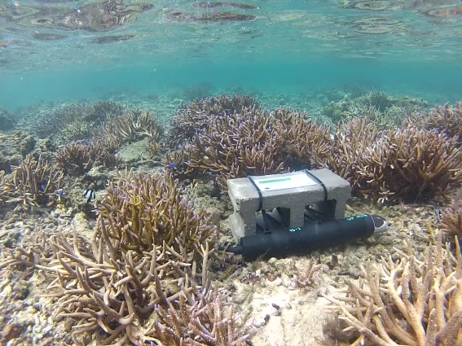
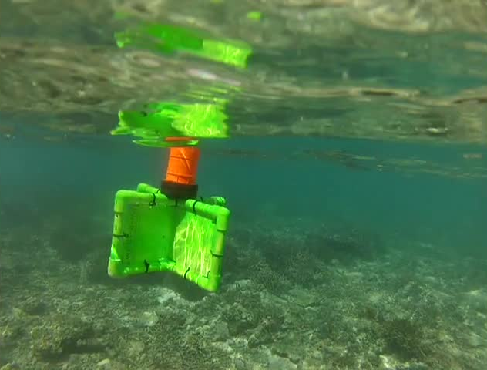
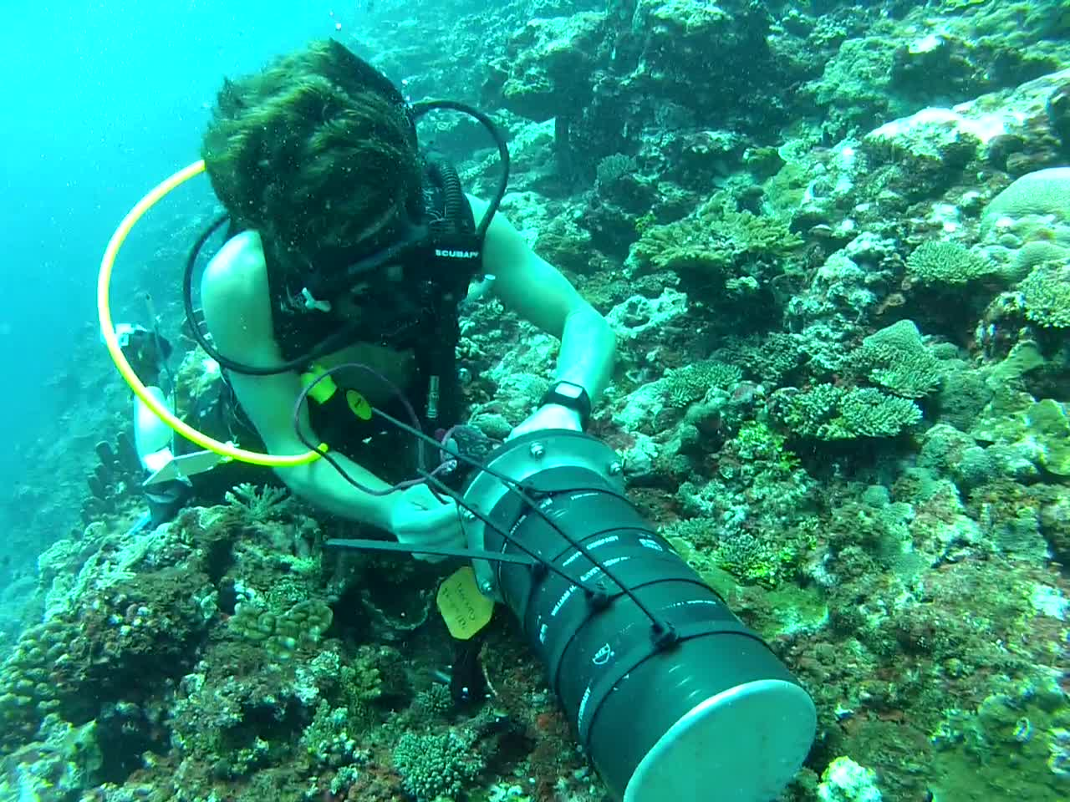
Methods
Combination of Eulerian and Lagrangian Methods
Eulerian (ADCP):
Higher temporal coverage
$20k each, thanks Curt!
3 deployed for one week
Lagrangian (Drifters):
Higher spatial coverage
$100 each, constructed on-island
5 drifters per deployment
22 deployments concurrent with ADCP
8 deployments opportunistically
Wave, wind, tide forcing data:
In situ wave gauge, weather station
Local weather and tide station
NOAA WaveWatch3 model output

Slide 11
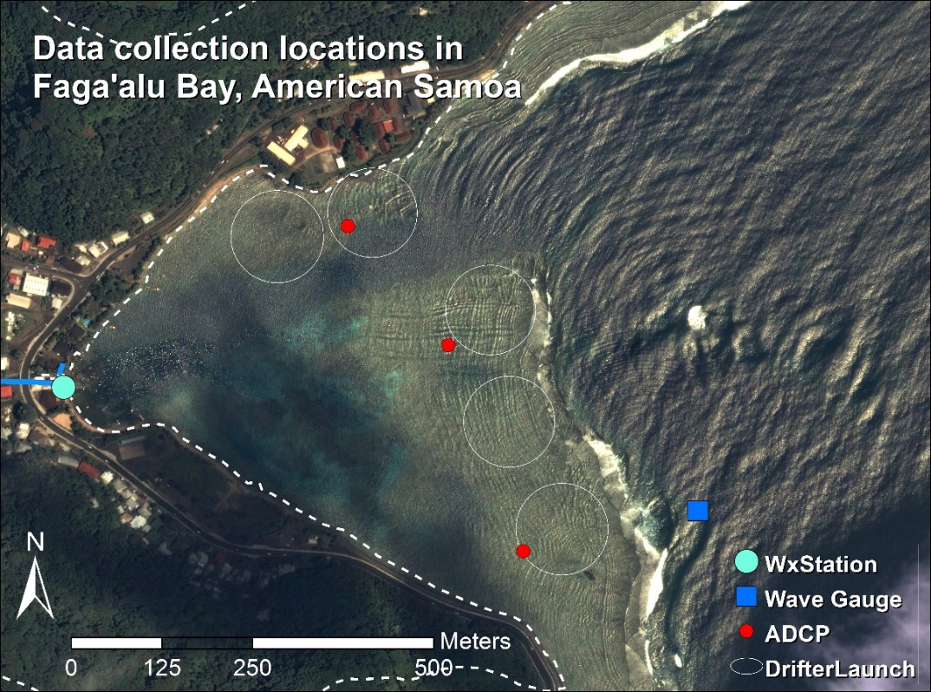

Slide 12
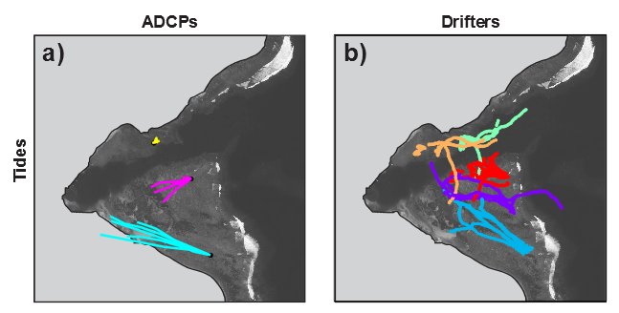
Methods
Compare drifter tracks with ADCP Progressive Vectors
Progressive vectors calculated from fixed ADCP (a)
Drifters illustrate flows are highly variable in the enclosed bay (b)
*both standardized to 1 hour travel times

Slide 13
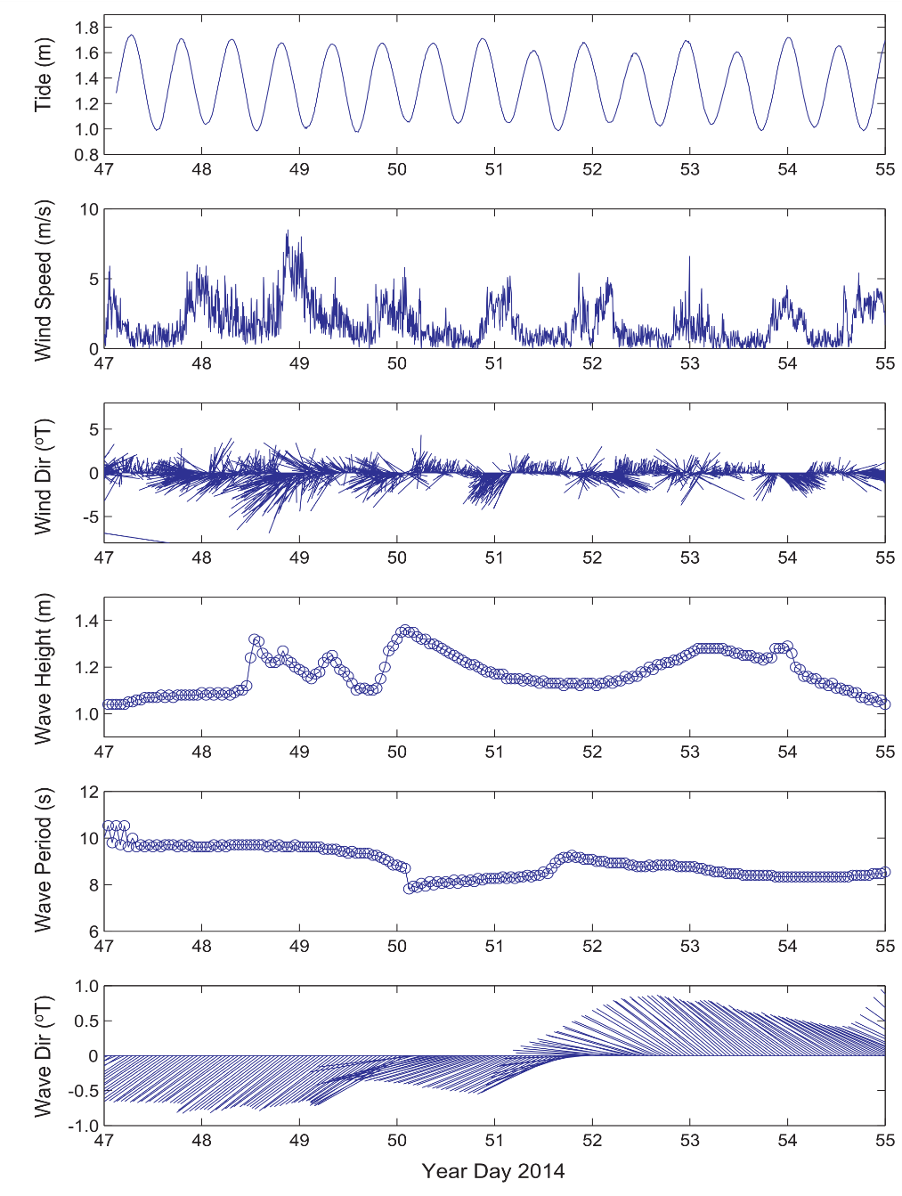
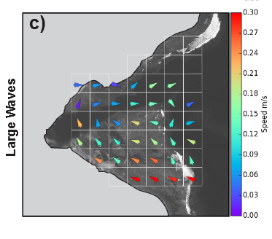
“End-Member Conditions”
Wave = High wave height, Low wind speed
Wind = Low wave height, High wind speed
Tide = Low wave height, Low wind speed
Wind
Tide
Wave
Tide
e.g. Mean velocity under “Wave” conditions
Wind
speed
Wind
dir
Wave
height
Wave
per
Wave
dir
Mean velocity is used to model Residence time for Paper Three

Slide 14
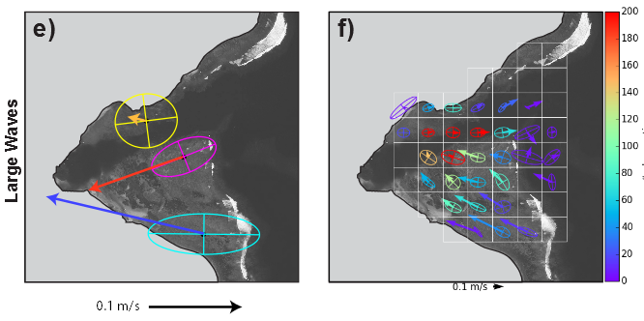
Compare Variance Ellipses and Eulerian Mean Vectors (Hoeke 2012):
How coherent/variable is the flow velocity under end member conditions?
Variance can be masked by mean velocity
Number of observations
Notes:
Hoeke 2012:
The fact that the semimajor axis of flow is strongly
oriented into the bay at the Wall site during NW swell
events, and to a lesser extent during trade wind conditions,
suggests that wave‐driven flow over Hanalei reef is a sig-nificant circulation driver within the bay. Unfortunately, the
bay’s complex fringing reef topography

Slide 15
Paper Three: Watershed and oceanic controls on spatial and temporal patterns of sediment accumulation in a fringing reef flat embayment
Motivation
Ryan 2008 correlated sediment deposition with increased sediment supply, but hydrodynamics can decrease sediment deposition and residence time
Bothner 2006 and Victor 2006 found weak or no correlation between sediment trap collection and rainfall but Duvert 2012 and Paper One illustrate SSY from small, mountainous watersheds can be poorly correlated with precipitation
Research Questions
How do flood-supplied terrigenous sediment and hydrodynamic conditions interact to control the gross and net rate of terrigenous sediment deposition at monthly time scales in a coral reef embayment?
H: Terrigenous sediment deposition highest when SSY_{EV} during quiescent ocean conditions
2. What controls the spatial distribution of sediment accumulation, and can it be predicted by the flow velocities of water over the reef and distance from the stream mouth?
H: The spatial distribution of sediment accumulation will be controlled mainly by the flow velocity (direction away from stream mouth)
Notes:
In contrast to many small, mountainous watersheds in temperate coastal regions where fluvial discharge and wave energy commonly coincide (Warrick et al., 2004), discharge, deposition, and reworking of flood sediment are often decoupled on tropical islands, causing high deposition rates and residence times of terrigenous sediment Conversely, seasonal wind and wave patterns in the tradewind belt can be coupled with sediment discharge or resuspension to decrease sediment deposition and residence times (Hoitink and Hoekstra, 2003; Muzuka et al., 2010)
:
1) by flushing suspended sediment away from the corals before it can be deposited (residence time = 0 min)
2) resuspending and removing sediment that has been previously deposited

Slide 16
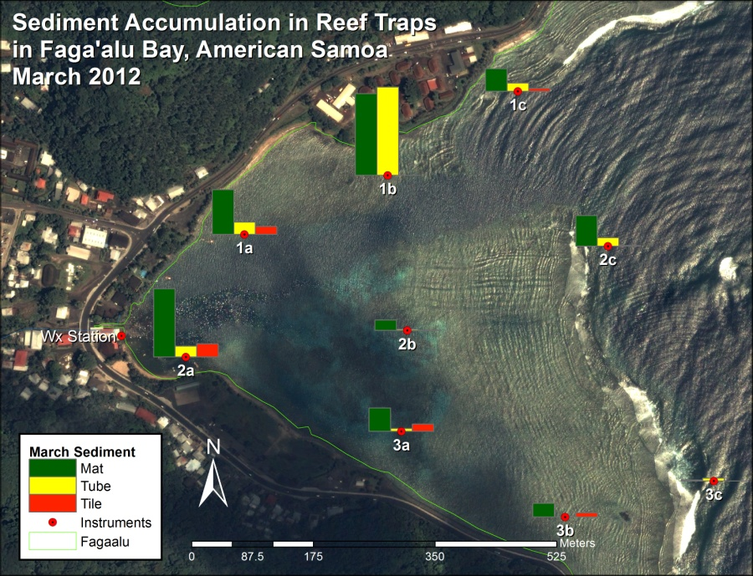
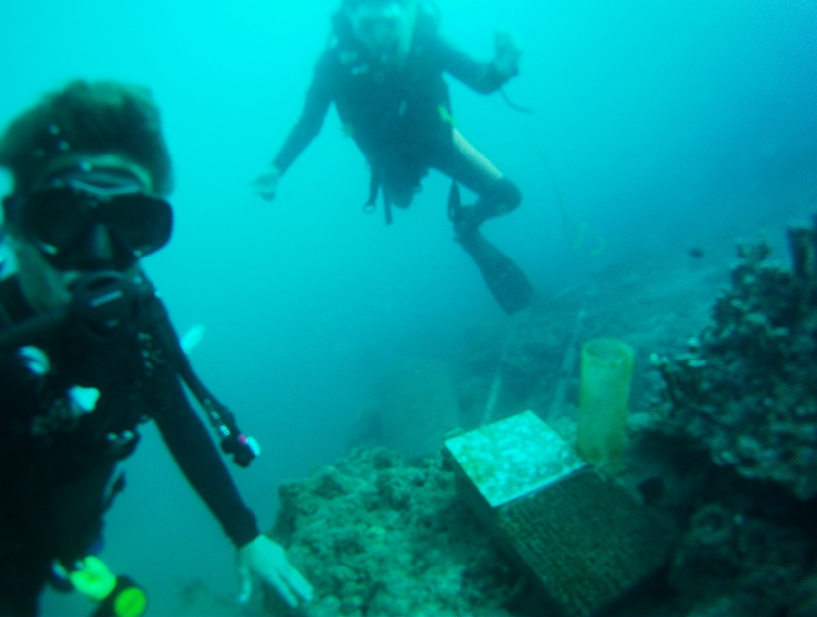
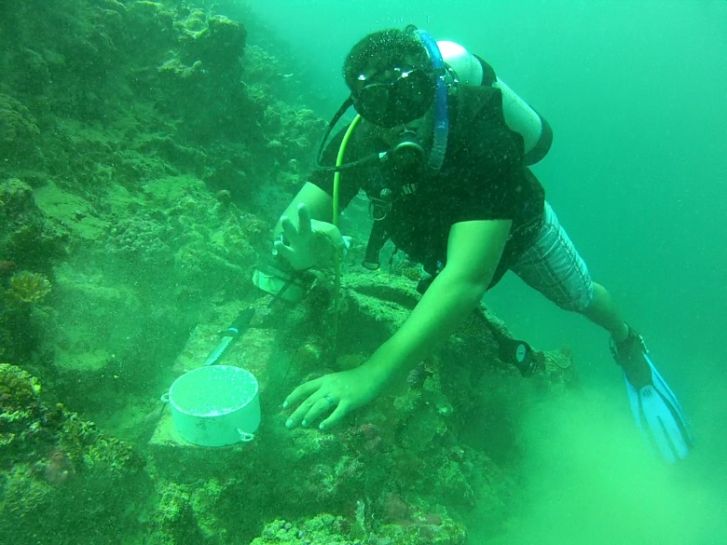
Methods
Terrigenous sediment accumulation in Tubes (gross), and SedPods (net)
Tube
A pilot study measured highly variable sediment accumulation, among sites and instruments
Terrigenous fraction by Loss On Ignition (LOI)
SedPod

Slide 17




Methods
Net sediment accumulation
Monthly sediment input
$$S_{w}(t)= \sum_{i=1}^{n}{{SSY}_{i}}$$
Monthly sediment accumulation
$$S_{i}(t)=f\left(S_{w}(t),R_{i}(t),{SB}_{i}\right)$$
Paper One
Paper Three
Water residence time
$$R_{i}\left(t\right)=a{\overline{H_{s}}}^{−b}$$
Paper Two
Spatial Distribution
Compare flow direction or distance from the stream
Normalized sediment accumulation will be compared among traps
$$\frac{S_{i}\left(t\right)}{{SedAcc}_{MAX}}=f\left(V_{θi}(t),d_{i}\right)$$
V_{ϴi} = mean flow velocity away from the stream mouth
d_{i} = distance from the stream mouth at location i.
Notes:
A monthly time interval was chosen to correspond with other studies found in the literature (Muzuka et al., 2010; Victor et al., 2006), to include enough storm events to collect enough sediment for analysis, and for logistical reasons due to the high spatial coverage of sites and limited field personnel and resources.
Eq 1 where S_{w}(t) is total sediment loading from Faga'alu Stream in month t, R_{i}(t) is mean water residence time over the reef flat at location i (either the mean of the month or mean during storm events), and SB_{i} is substrate type (live coral, dead coral, coralline sand, mud) at location i, which is a proxy for sediment availability in the microenvironment around the sampling location.
Use mixture model if S and R are colinear
Eq 2 S_{W} is the sum of SSY_{i} for n events in the month, calculated from Equation 4.
Eq 3 where R_{i}(t) is the water residence time for month t, $\overline{H_{s}}$ is mean monthly swell height, and a and b are calibration coefficients that differ for each grid cell. Depending on the modeling results from Paper Two, it may be necessary to calculate and average water residence time daily to determine mean monthly residence time, or include a term for wind-driven flow.

Slide 18
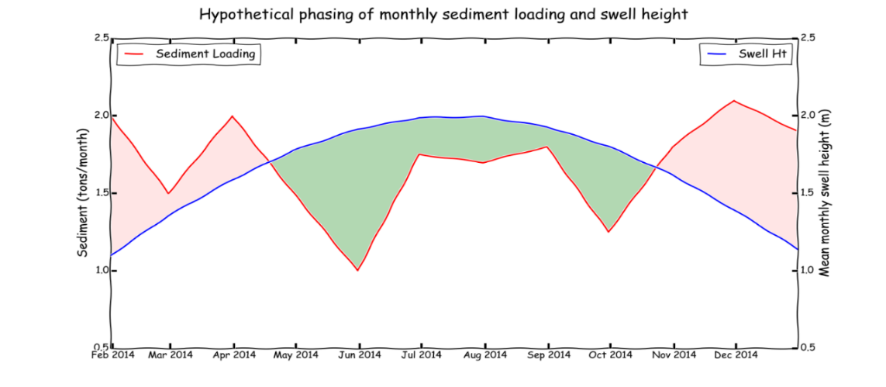
Temporal Distribution
Two time scales of analysis will be used: Monthly and Seasonal (dry/wet season)
May have to investigate daily time scale
Net removal
Net deposition
Net deposition

Slide 19
Timeline to complete proposed research
Month | Paper One | Paper Two | Paper Three
September | Manuscript preparation | Manuscript preparation | Field work
October | Manuscript preparation | Manuscript preparation | Field work
November | Manuscript preparation | Manuscript preparation | Field work
December | Manuscript preparation | Manuscript preparation | Field work
January | Manuscript preparation | Manuscript preparation | Sample analysis
February | Manuscript preparation | Manuscript preparation | Sample analysis
March |  |  | Manuscript preparation
April |  |  | Manuscript preparation
May |  |  | Manuscript preparation

Slide 20

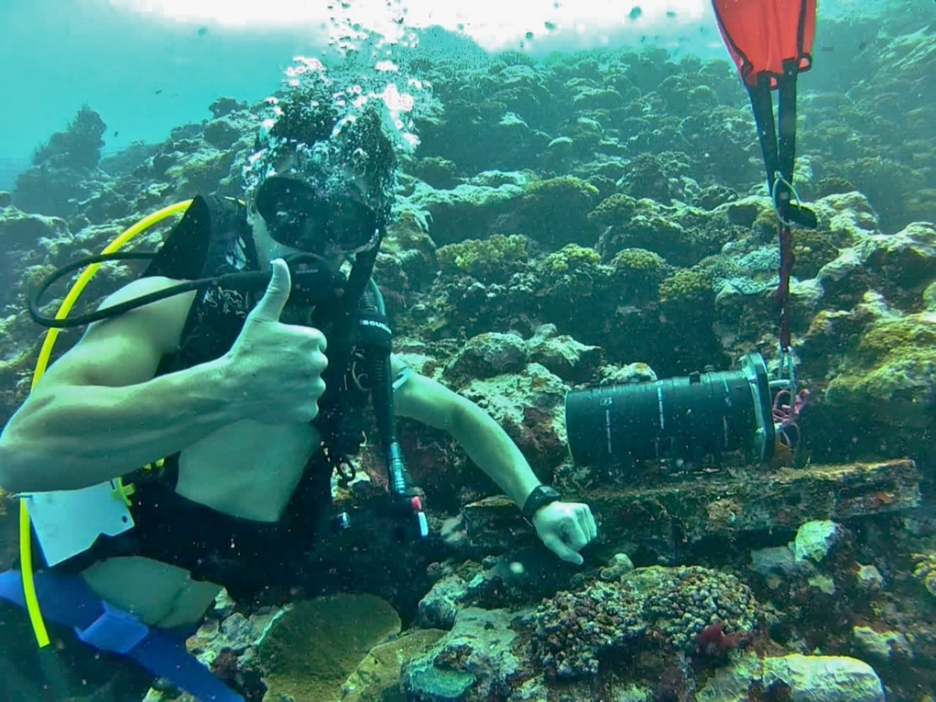
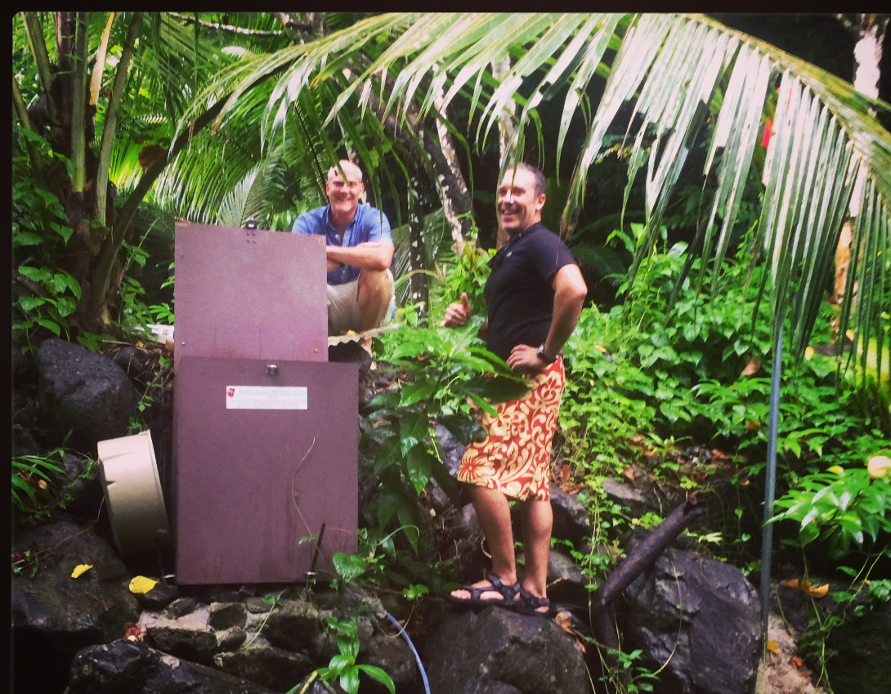
Fa’afetai! (Samoan for Thank you)
Questions?

